Slide 1

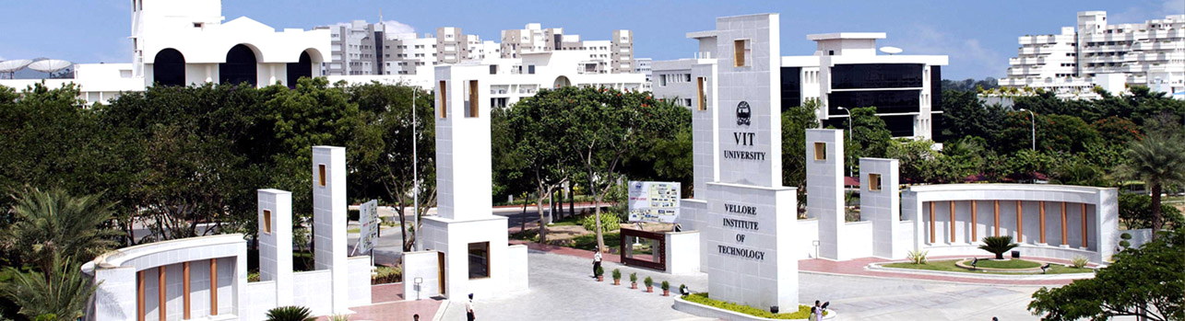
FALL DETECTION OF ELDERLY PEOPLE
SIJO BABY MATHEWS - 14BEC0080
B.Tech Electronics and Communication Engineering
Final Review Presentation
School of Electronics Engineering
Prof. Abhijit Bhowmick
Project Guide
Date of Presentation: 21/04/2018

Slide 2
CONTENTS
Introduction
Literature Review
Knowledge gained
Gaps identified from literature
Objectives
Equipment and Technical Specification
Methodology
Results & Discussion
References
B.Tech Electronics and Communication Engineering – Final Review Presentation - SENSE

Slide 3
Introduction
The major cause of injury and accidental deaths in old people is due to unexpected fall. According to recent statistics, majority of serious consequences are not due to direct fall but due to lack of immediate attention and treatment. Post-fall consequences can be reduced if relief personnel are alerted in time. Many modern old people prefer living alone independently after their children have grown up and leave home. It is so common that after a fall an elderly is unable to get up by themselves or contact someone for help. Thus, there is a need for an automated fall detection system such that he or she can summon help when they are unable to get up or is unconscious.
Many algorithm has already been developed but still it is difficult to differentiate real falls from certain activities such as sitting quickly, jumping which results in many false positives, as it uses accelerometer to detect fall with body orientation as ending position is not always horizontal. E.g. fall on stairs.
The fall detection algorithm can be developed is using both accelerometer and gyroscope reducing both false positives and false negatives, while improving fall detection accuracy. It notifies a concern person with SMS either automatic when fall occurs or with a panic button.
B.Tech Electronics and Communication Engineering – Final Review Presentation - SENSE

Slide 4
Literature Review
Title of the paper | Journal & Year | Authors | Description | Remarks
"A wearable wireless fall detection system with accelerators" | 2011 IEEE International Conference | D. Chen, W. Feng, Y. Zhang, X. Li and T. Wang | DOI: 10.1109/ROBIO.2011.6181634 | Accelerometer to detect fall.
“Activity Analysis, Summarization, and Visualization for Indoor Human Activity Monitoring” | IEEE Transactions on Circuits and Systems for Video Technology ( Volume: 18, Issue: 11, Nov. 2008 | Zhongna Zhou, Xi Chen, Yu-Chia Chung, Zhihai He | DOI: 10.1109/TCSVT.2008.2005612 | Microsoft Kinect and cameras used for monitoring elderly while they are indoors.
"Risk factors for serious fall related injury in elderly women living at home." | Injury Prevention (2004): | Bergland, A., and TB Wyller. | doi:10.1136/ip.2003.004721 | risks faced by women after a fall which results in injury
B.Tech Electronics and Communication Engineering – Final Review Presentation - SENSE

Slide 5
Literature Review
Title of the paper | Journal & Year | Authors | Description | Remarks
"Risk Factors in Falls Among the Elderly According to Extrinsic and Intrinsic Precipitating Causes." | European Journal of Epidemiology, 2000 | Bueno-Cavanillas, A.F. Padilla-Ruiz, J. J. Jiménez-Moleón | doi:10.1023/A:1007636531965 | Various risks factors that result in fall of old people.
"Evaluation of a threshold-based tri-axial accelerometer fall detection algorithm." | Gait & Posture (2007) | Bourke, A. K., J. V. O’Brien, and G. M. Lyons | doi:10.1016/j.gaitpost.2006.09.012 | Threshold value for fall detection was obtained from this research paper.
B.Tech Electronics and Communication Engineering – Final Review Presentation - SENSE

Slide 6
Knowledge Gained from the Literature
32% of elderly people aged over 75 years have ever fallen at least once a year, and along with them, 24% have dangerously injured. Fall related injuries are the leading source of death and hospitalization surrounded by the elderly. Falls among older people become a major problem facing hospitals and nursing homes.
The need of support in the case of unconsciousness or extreme injury is the main reasons why elders leave the comfort and privacy of their own home to live in an assisted-care environment.
Visual monitoring using cameras and Microsoft Kinect to detect the fall is efficient method.
B.Tech Electronics and Communication Engineering – Final Review Presentation - SENSE

Slide 7
Gaps in the Literature
Visual observation with some visual device which can observe the person continuously and then image analyser which can analyse the fall of the person and generate alarm. These systems use sensors deployed in the environment to detect falls. The main advantage of this system is the person does not need to wear any special device. The scope of this kind of device is limited to monitoring region (Majorly indoors) cannot be carried all the time with the person Information provided by device is quite accurate but such equipment will cost higher.
As for fall detection through an accelerometer, the scope of activity is relatively unrestricted; the device is easily attached to the human body, and the cost of system is low as compared to vision based method.
B.Tech Electronics and Communication Engineering – Final Review Presentation - SENSE

Slide 8
Objectives
The main objectives of this work are:
(1) To design a fall detection system using low cost fall detector sensors,
(2) To develop an algorithm that can identify the body position of the elderly people whether it is in falling tendency, and
(3) To construct a system that can send an Emergency SMS to the contact person (e.g. next-of-kin or close relatives) stored in the system.
(4). To connect a pulse sensor and sent its value via SMS.
(5). GPS module to sent location as latitude and longitude via SMS.
B.Tech Electronics and Communication Engineering – Final Review Presentation - SENSE

Slide 9
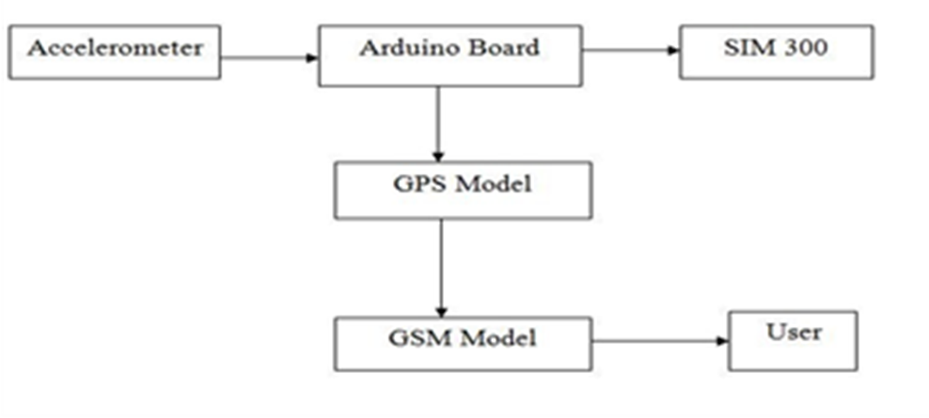
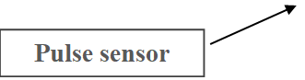
Objectives
Block representation of the model
B.Tech Electronics and Communication Engineering – Final Review Presentation - SENSE

Slide 10
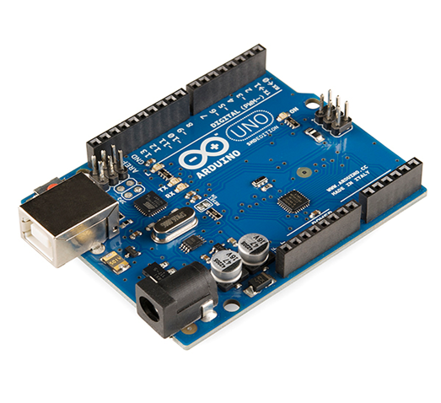
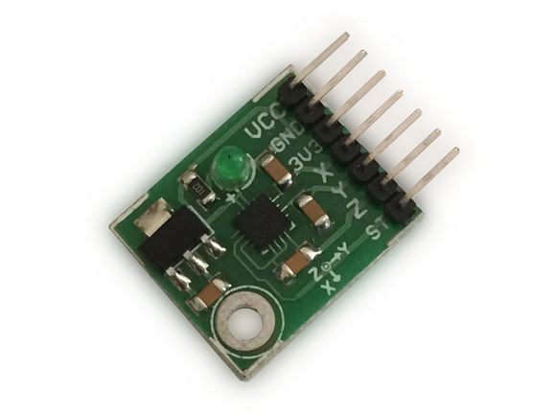
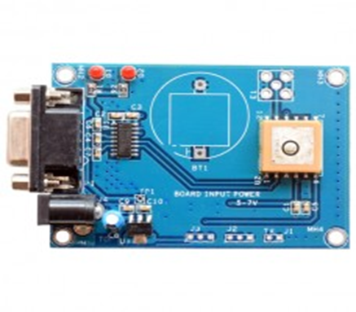
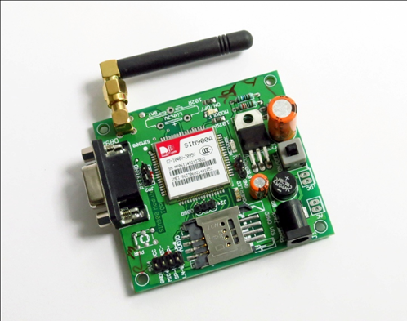
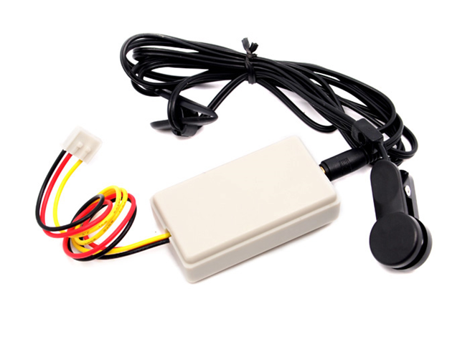
Equipment & Technical Specifications
SYSTEM REQUIREMENTS
• ARDUINO UNO
• ACCELEROMETER
• GPS
• GSM
PUSH BUTTON
PULSE SENSOR
SOFTWARE TOOLS
• ARDUINO IDE
• EMBEDDED C
B.Tech Electronics and Communication Engineering – Final Review Presentation - SENSE

Slide 11
Methodology
During a fall, a person experiences a momentary freefall or reduction in acceleration, followed by a large spike in acceleration, then a change in orientation.
We see the algorithm checks to see if the acceleration magnitude (AM) breaks a set lower threshold. If this lower threshold is broken, the algorithm then checks to see if AM breaks a set upper threshold within 0.5s. If this upper threshold is broken, the algorithm then checks to see if the person’s orientation has changed in a set range within 0.5s, which would indicate a person has fallen or toppled over. If the person’s orientation has changed, the algorithm then examines to see if that orientation remains after 10s, which would indicate the person is immobilized in their fallen position on the ground. If this holds true, the algorithm recognizes this as a fall. A failure of any of the intermediate decision conditions would reset the triggers and send you back to the start. The strength of this algorithm is that it requires an activity to break two AM thresholds and have an orientation change. Ideally this additional lower threshold would reduce the number of false positives.

Slide 12
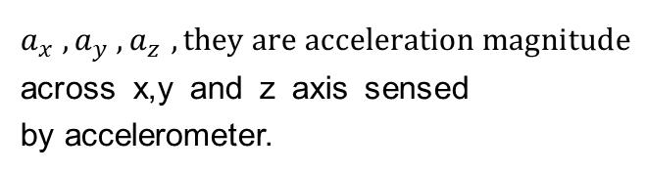

Methodology
START
Collectiong data from ADXL335
Calculate acceleration magnitude
(AM)
$$AM=\sqrt{a_{x}^{2}+a_{y}^{2}+a_{z}^{2}}$$
AM breaks lower threshold?
$$a_{x}^{},a_{y}^{},a_{z}^{},they are acceleration magnitude$$
across x,y and z axis sensed by accelerometer.
AM breaks upper threshold within .5s
orientation change in range within .5s
Orientation remains after 10s?
Fall detected & trigger GSM

Slide 13
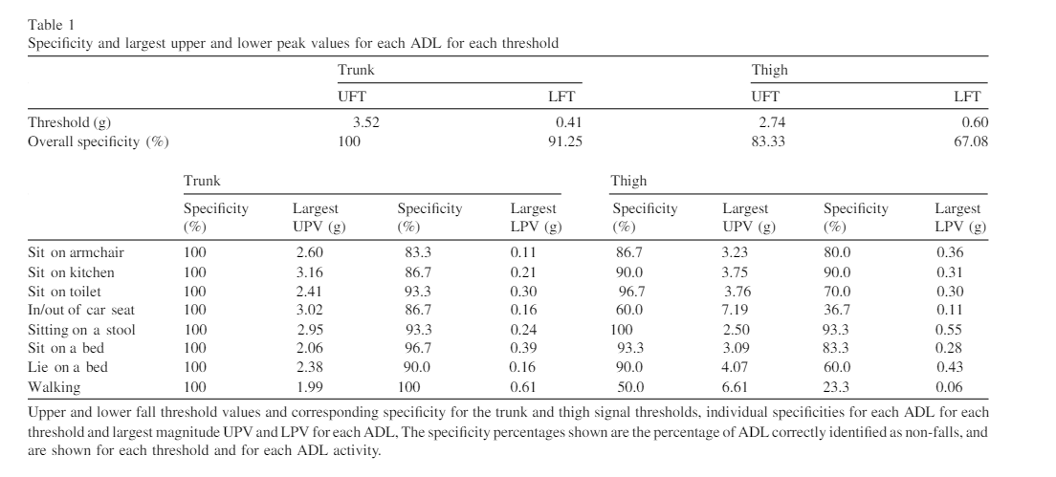
Methodology
Tabular representation of Upper and lower peak values of acceleration(g) during various ADL(activities in daily living)
B.Tech Electronics and Communication Engineering – Final Review Presentation - SENSE

Slide 14
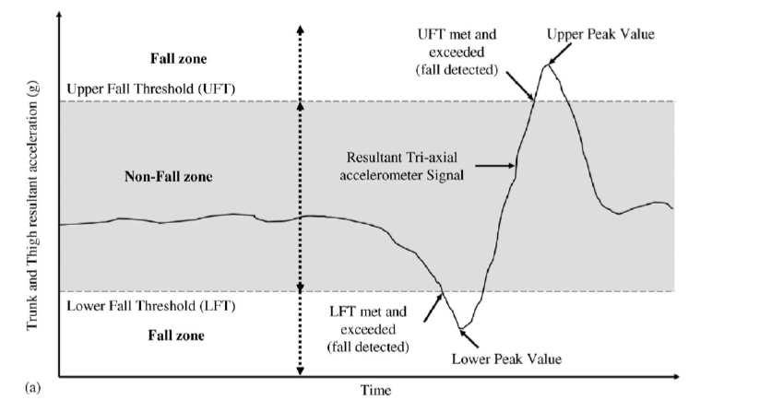
Methodology
Graph showing the upper fall threshold and lower fall threshold reach during a fall. It is plotted
In accordance with resultant acceleration(g)v/s time
B.Tech Electronics and Communication Engineering – Final Review Presentation - SENSE

Slide 15
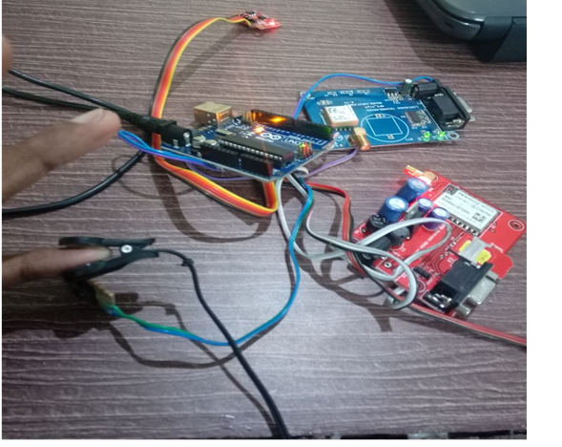
Results and Discussion
The project is build with Arduino uno used as a microcontroller to control the sensors(pulse , accelerometer) and modules(GPS, GSM) and execute such that it provides desired results.
This setup has to be attached to waist /chest and pulse sensor attached to finger of the user.
Two cases of results scenarios are possible using this model, they are explained in detail
Hardware Setup
B.Tech Electronics and Communication Engineering – Final Review Presentation - SENSE

Slide 16
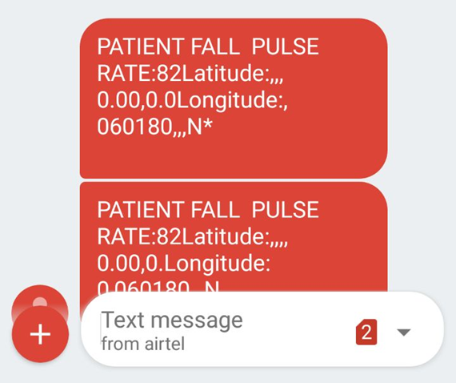
Results and Discussion
Scenario 1:
When the fall is automatically detected by the working model,
It sents a message to caretaker informing about the fall detected and the pulse rate at the time of fall along with the latitude and longitude location of the victim who has fallen and need immediate assistance.
Scenario 1
B.Tech Electronics and Communication Engineering – Final Review Presentation - SENSE

Slide 17
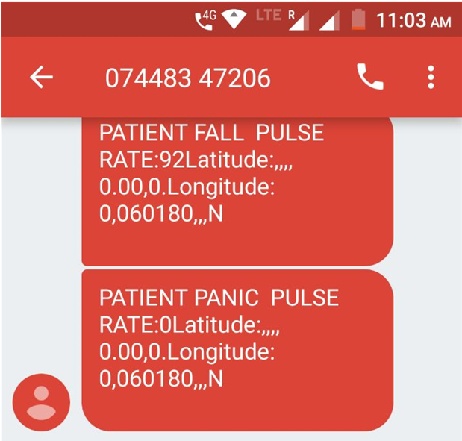
Results and Discussion
Scenario 2:
When the person itself feels unwell and is in need of assistance, he has a provision to press panic button which sents response to caretaker along with heart rate and location of the user .
Scenario 2
B.Tech Electronics and Communication Engineering – Final Review Presentation - SENSE

Slide 18
Conclusions
The results of the project is satisfactory with desired output of fall detection of a person.
The output comprises of an SMS to caretaker confirming the fall detection, along with the pulse rate during that fall and the latitude and longitude location of the victim.
The pulse rate value is an advantage if it is abnormal then we can make sure the situation of the user is bad and can take immediate action to help that person.
There is also a panic push button, in case of emergency ,the user can press and notify the caretaker that he is not well and require assistance.

Slide 19
Future Directions of the Work
This project is a prototype design. however if you can include two more accelerometer to be attached in thighs ,you can also monitor the sleep cycle of the person.
The prototype can be implemented in real time using advanced technology by means of Smartphones.
Latest Smartphones have built in accelerometer sensor (motion sensor), GPS and GSM and certain phones even has pulse sensor.
Hence , an application can be developed on Android/Apple Appstore which can work similar to this project.

Slide 20
References
[1] World Health Organisation. Global report on falls prevention in older age. World Health Organisation,2007.
[http://www.who.int/ageing/publications] Falls_prevention7March.pdf]
[2] Bergland, A., and TB Wyller. "Risk factors for serious fall related injury in elderly women living at home." Injury Prevention (2004): doi:10.1136/ip.2003.004721.
[3] Yardley, Lucy, and Helen Smith. "A Prospective Study of the Relationship Between Feared Consequences of Falling and Avoidance of Activity in Community-Living Older People." Gerontologist (2002) .
[4] Tinetti, M. E., M. Speechley, and S. F. Ginter. "Risk factors for falls among elderly persons living in the community." (1989)
SENSE- ECE499 - Capstone Project - Final Viva-Voce Presentation

Slide 21
References
[5] Bueno-Cavanillas, A., F. Padilla-Ruiz, J. J. Jiménez-Moleón, C. A. Peinado-Alonso, and R. Gálvez-Vargas. "Risk Factors in Falls Among the Elderly According to Extrinsic and Intrinsic Precipitating Causes." European Journal of Epidemiology, 2000. doi:10.1023/A:1007636531965.
[6] Rafael Luque, Gema Redondo , María-José Morón , and Eduardo Casilari. "Comparison and Characterization of Android-Based Fall Detection Systems." Sensorsdoi:10.3390/s141018543.
[7] Bourke, A. K., J. V. O’Brien, and G. M. Lyons. "Evaluation of a threshold-based tri-axial accelerometer fall detection algorithm." Gait & Posture (2007): doi:10.1016/j.gaitpost.2006.09.012
SENSE- ECE499 - Capstone Project - Final Viva-Voce Presentation

Slide 22
Acknowledgements
VIT Management
HOD
Parents
Internal and External Guides
Staff members

